Slide 1
Gen2 Tracker Using YOLO Darknet Model
Liqiang Ding

Slide 2
Outline
0. Milestone plan
1. Detection demo
2. Customized training using traffic surveillance videos
3. Tracking algorithm
4. Tracking demo
5. Potential problems and solutions.

Slide 3
0. Milestone Plan

Slide 4
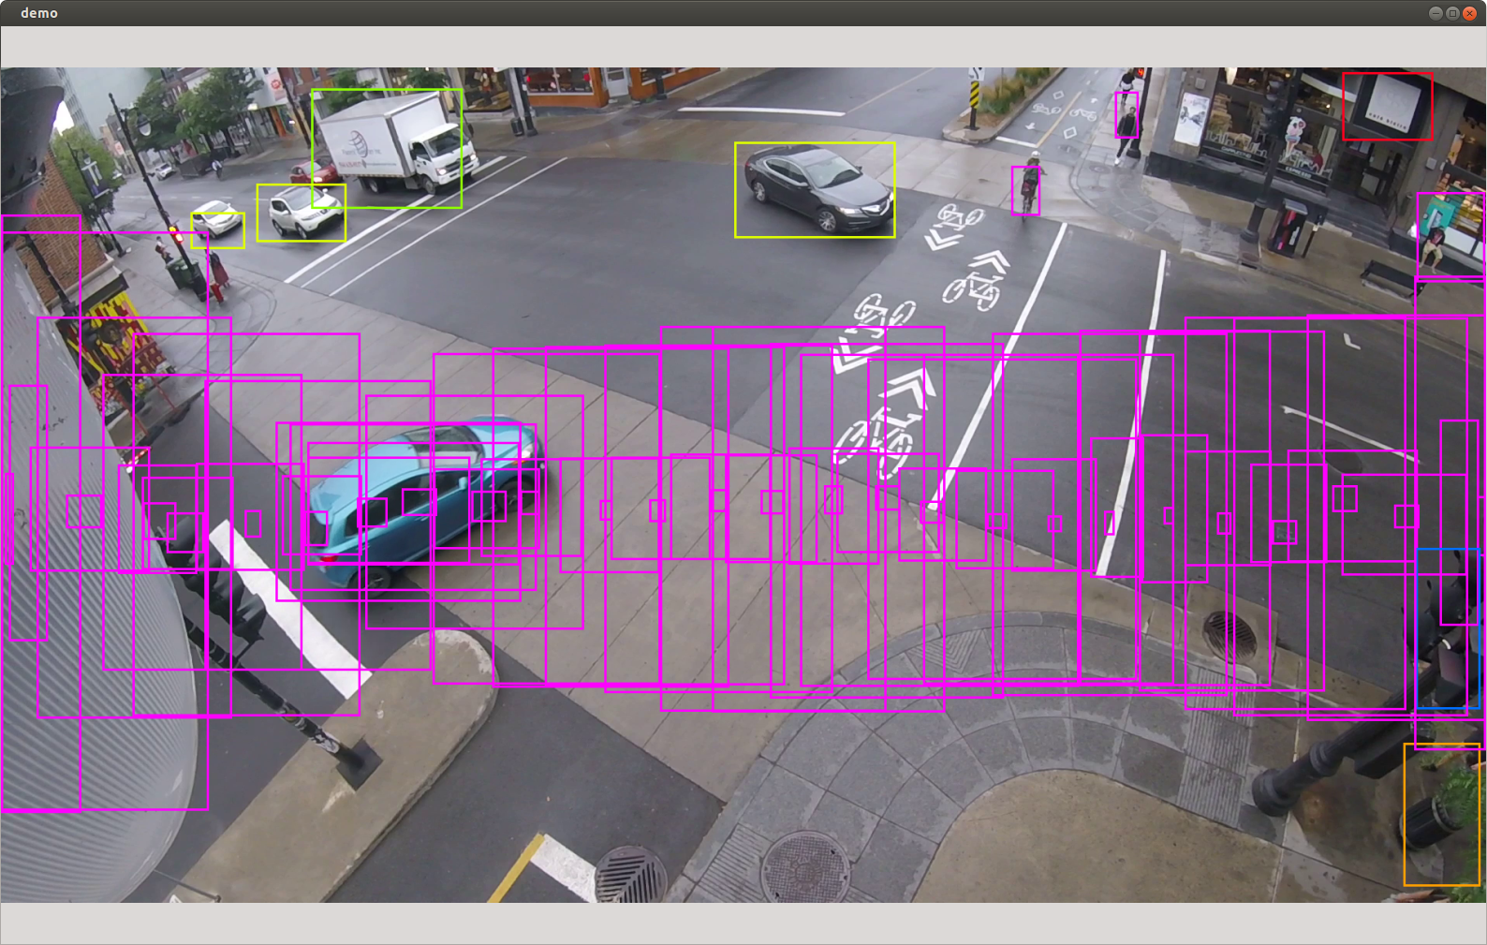
1. Detection Demo
YOLO Darknet model
Fast, Flexible, Accurate
Divide an image into many small cells and ask if there is anything inside?

Slide 5
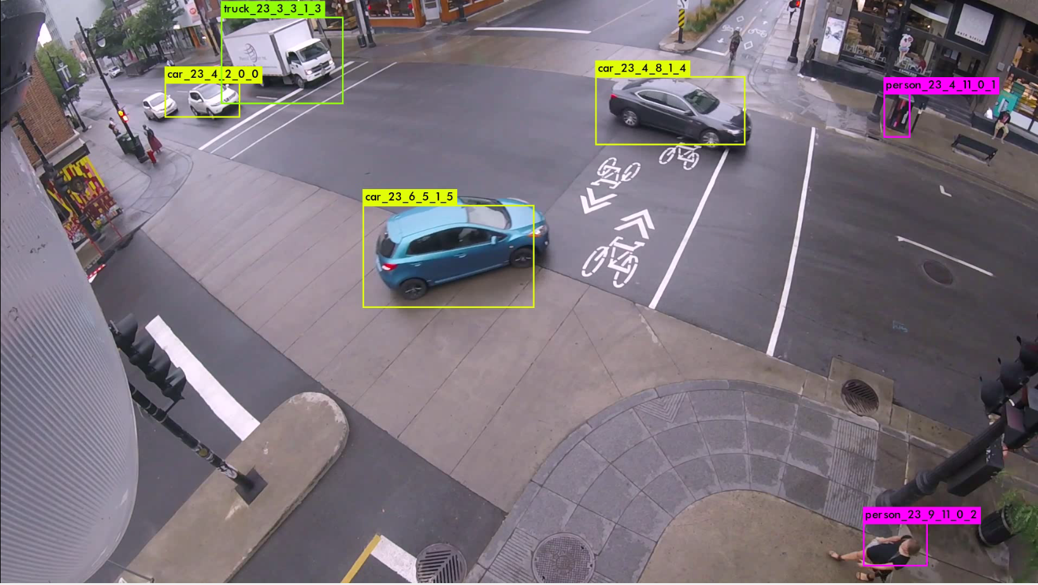
1. Detection Demo

Slide 6
1. Detection Demo
Deep learning needs a huge number of training images and labels to learn from.
Pretrained on ImageNet dataset (Stanford, 1 million images)
Pretrained on COCO dataset (Microsoft, 328,000 images )
Problems with pretrained-model:
Different viewpoints
Different object classes
Different object sizes
…

Slide 7
1. Detection Demo
We need to train our own model with our training images and labels.
Better detection and recognition
Easier for tracking later on

Slide 8
2. Customized Traffic Surveillance Videos Dataset
MIO-TCD dataset,
Collected by Miovision Technologies Inc and Université de Sherbrooke
Public available
137,743 images and labels
Used as a challenge competition in CVPR 2017
Different times of days, and weather conditions

Slide 9
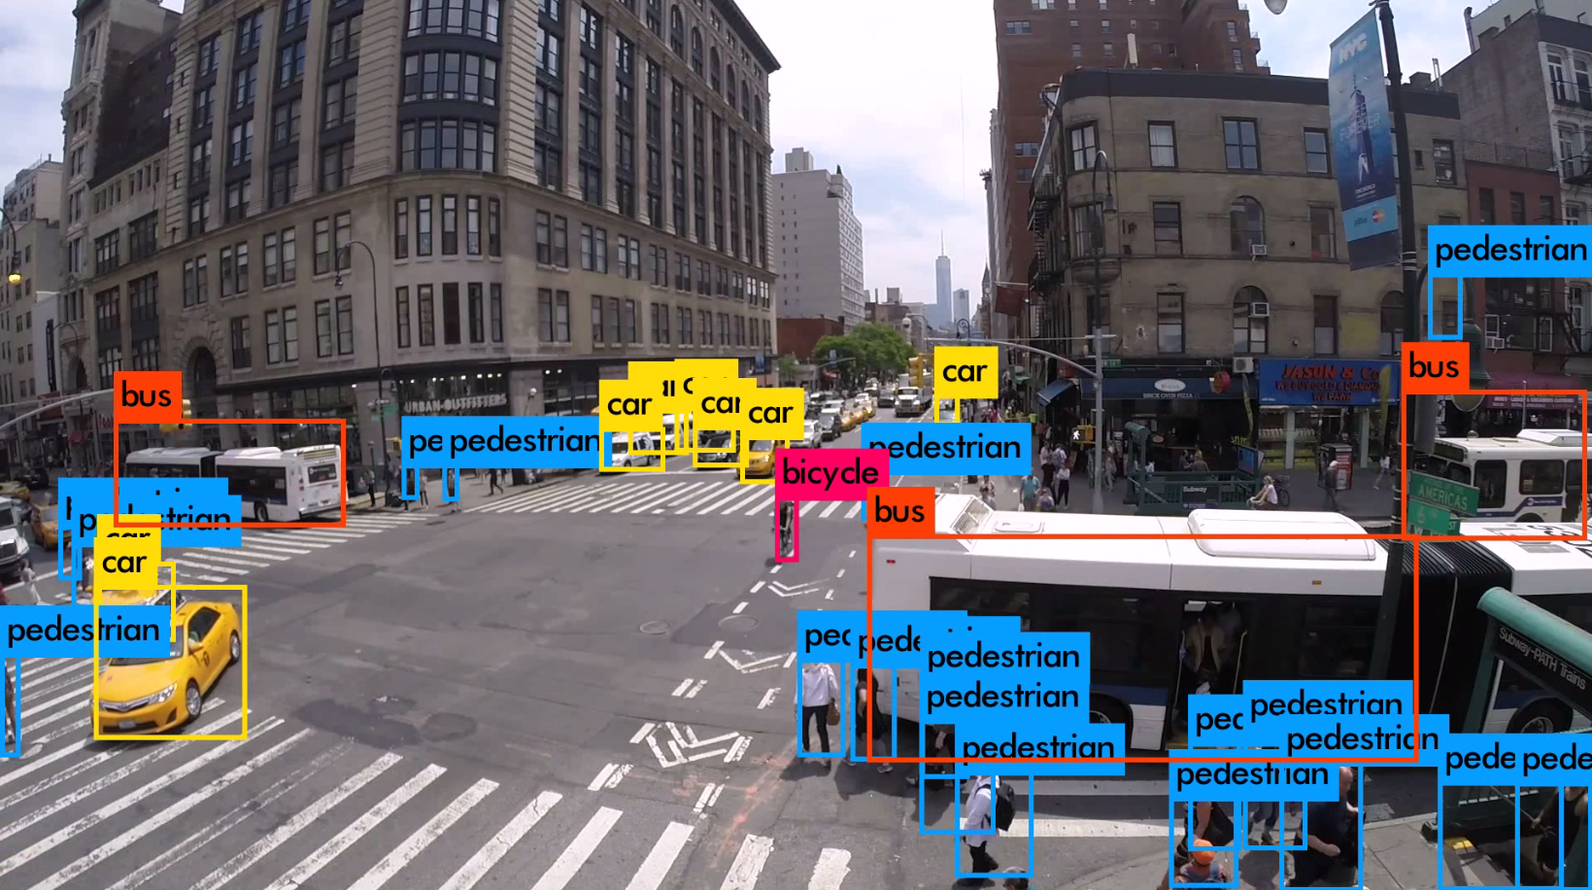

Slide 10
2. Customized Traffic Surveillance Videos Dataset
Problems:
Pedestrians are not well detected (Explicitly add more examples)
Need to optimize the model parameters (Learning rate, neuron numbers)
Training takes at least one week

Slide 11
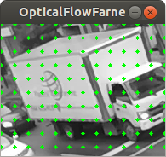
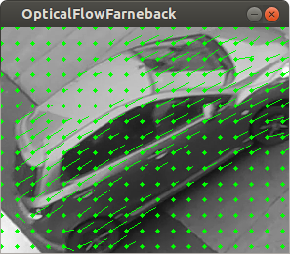
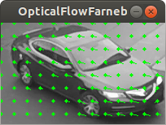
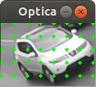
3. Tracking Algorithm
1. Optical Flow
Farnback Optical Flow vector and Lucas Kanade Optical Flow vector
Velocity vector indicating the motion speed and direction of moving object in the image
Update the optical flow vectors of each object iteratively

Slide 12
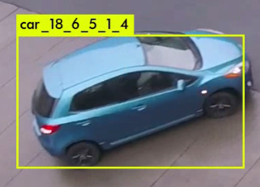
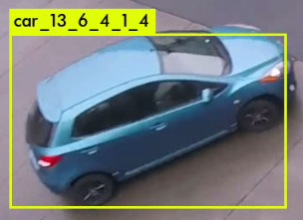
3. Tracking Algorithm
2. Class Category Information
The same object from one frame to the other stay the same class.
Ex. A car is always a car

Slide 13
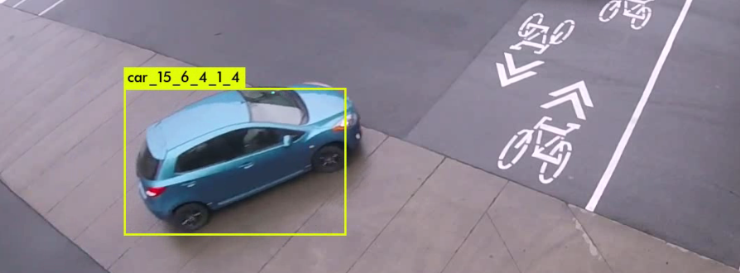
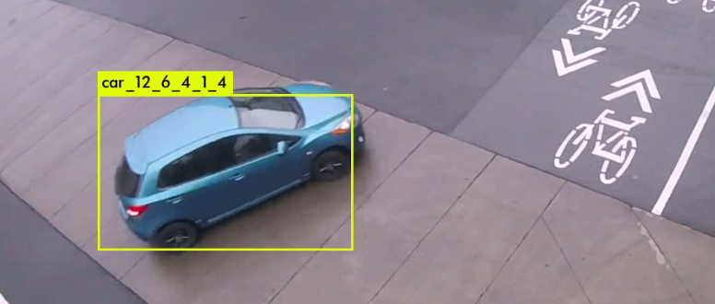
3. Tracking Algorithm
3. Position Information
Objects move will not move very far away from detected positions in the last frame.
Not a problem for a continuous video

Slide 14
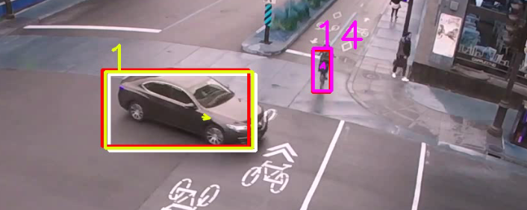
3. Tracking Algorithm
4. Kalman filter
Predictions of object positions in the next frame, based on position and motion information from previous frames.
Improves the tracking result.

Slide 15
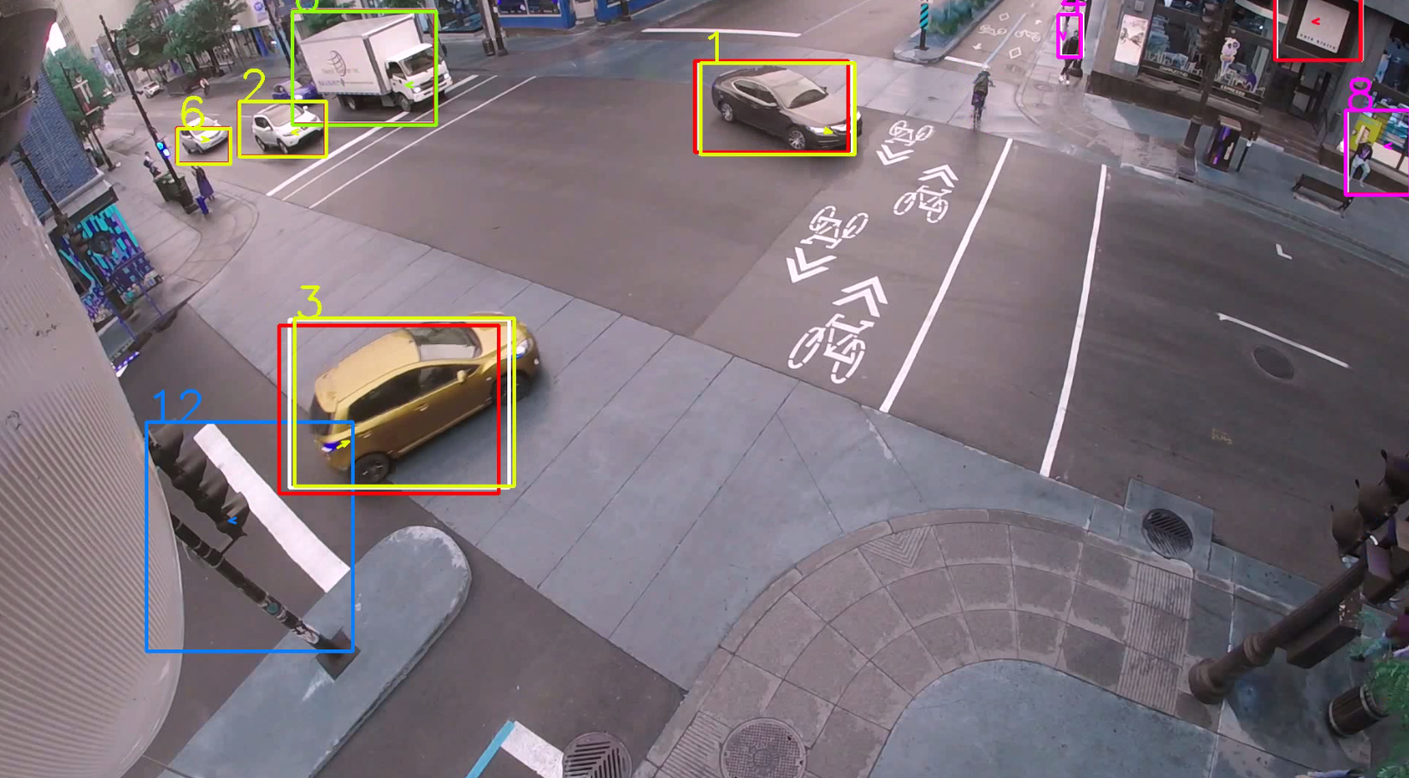
4. Tracking Demo

Slide 16
5. Potential Issues and Improvements
1. Occlusion
Ex. Bikes are blocked by the truck
Solutions:
1. Temporarily memorize the positions of objects and predict their possible positions based on Kalman filter and optical flow.
2. Loss of frames during detection
Ex. Small objects at far places are sometimes not well detected.
Solution:
1.Increase the bounding boxes number during the training phase to enlarge the detection areas
2.Test with higher resolution videos
3.Probablity augmentation algorithm

Slide 17
Questions?

